Slide 1
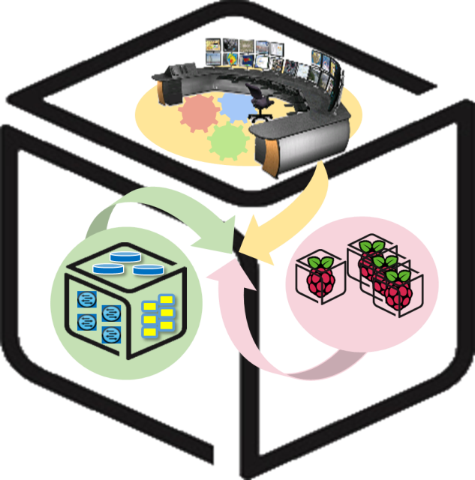



Computer Systems
For AI-inspired Cloud
Theory & Lab.
Lab #4: IoT
https://github.com/SmartX-Labs/SmartX-Mini-MOOC

Slide 2

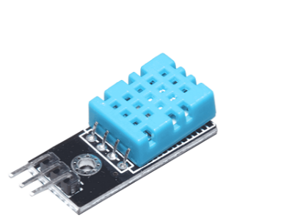

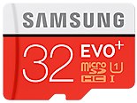

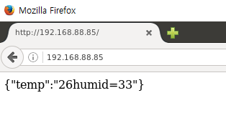






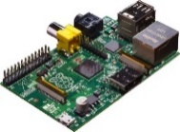
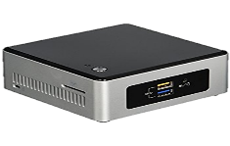

IoT Lab: Concept
Box provisioning / visibility
Sensor control message
Data Capture Function
Data Transfer Function
Web Server Function
Temperature/Humidity Sensor data
Docker
Runtime
Raspberry Pi Box
for IoT Sensors
& Actuators
NUC Box
for IoT-Cloud Hub
Tower Box
for IoT-Cloud Service Visualization

Slide 3



Theory

Slide 4

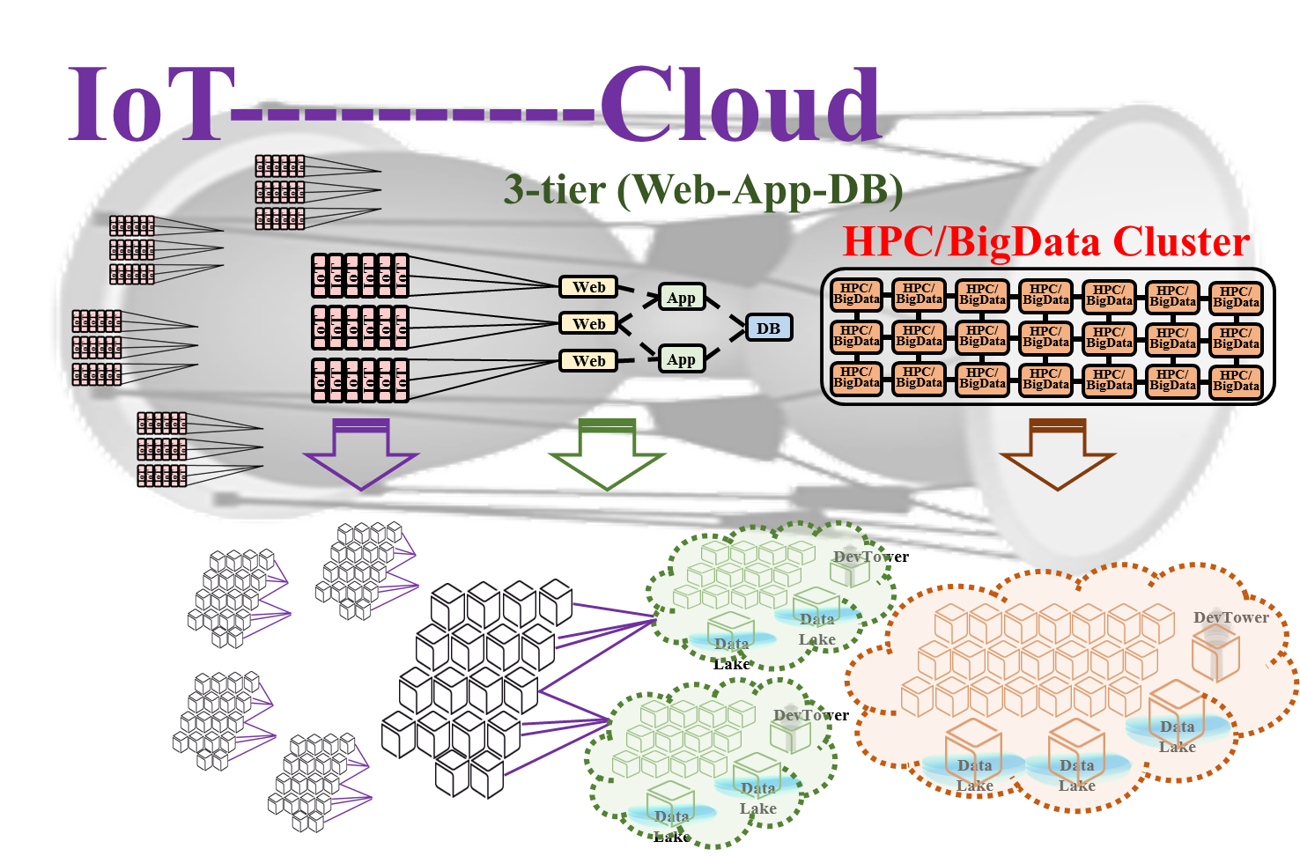




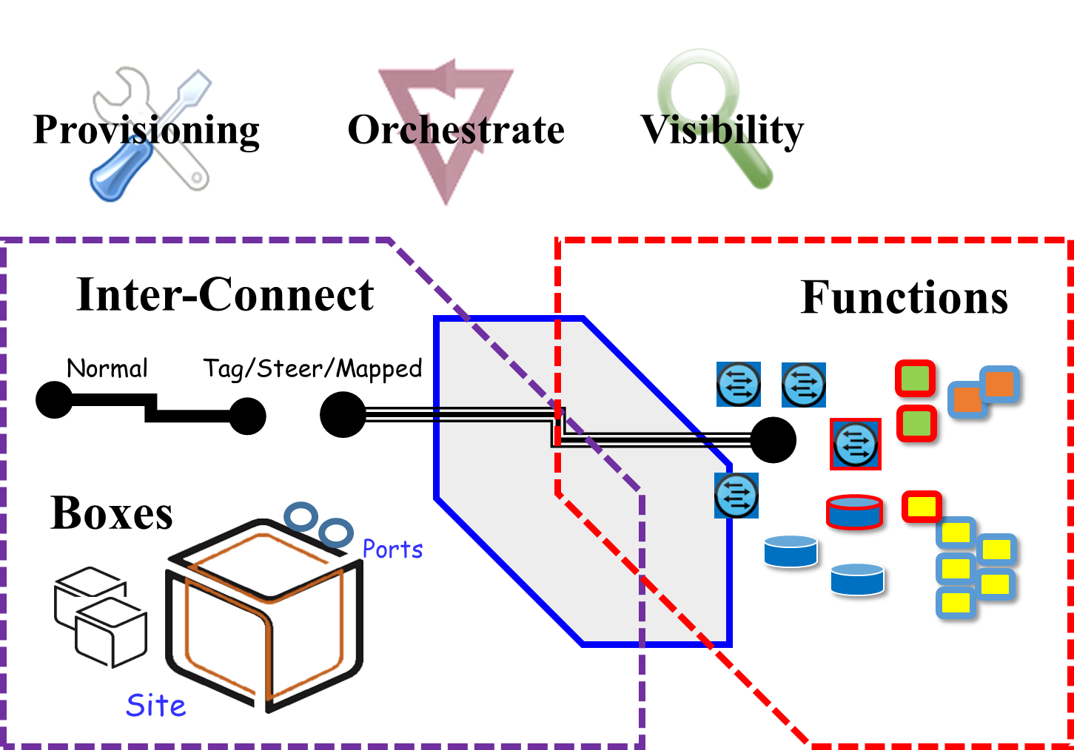




SmartX IoT-Cloud Services with Micoservices-based SaaS Applications
p(Baremetal)
+ c(Container)
+ v(VM)
Process containers
application containers
(Monster containers)
Machine containers
VM hypervisors

Slide 5
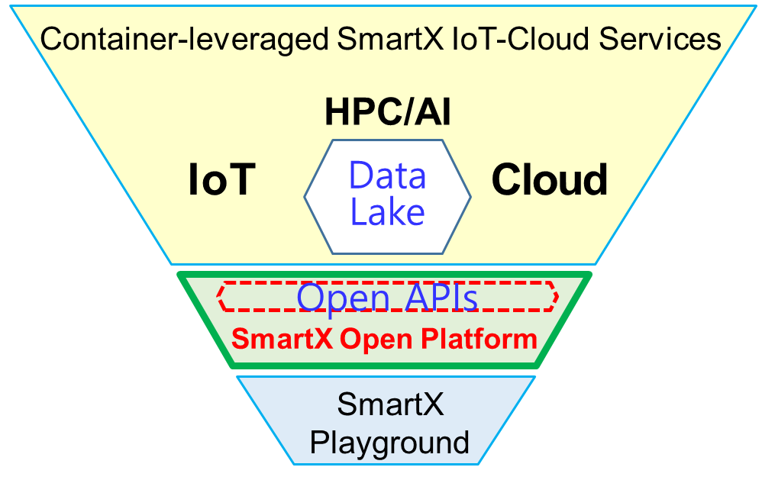





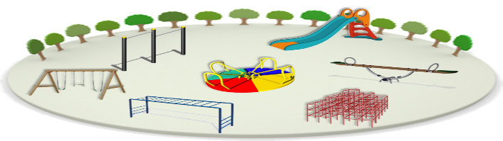

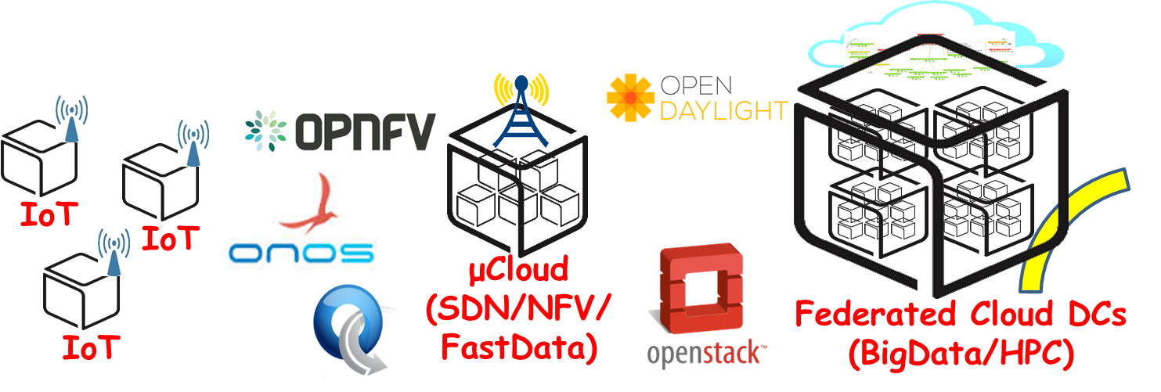


Open-Source-leveraged Playgrounds
(IoT-SDN/NFV-Cloud (HPC/BigData) Ready)
SmartX
Open Playgrounds

Slide 6

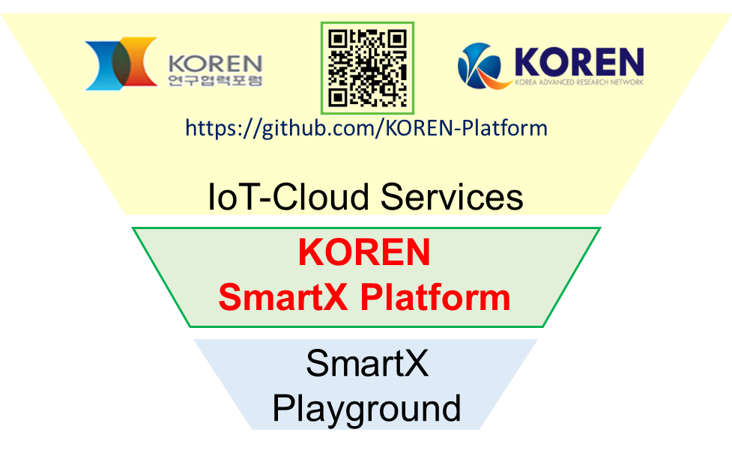

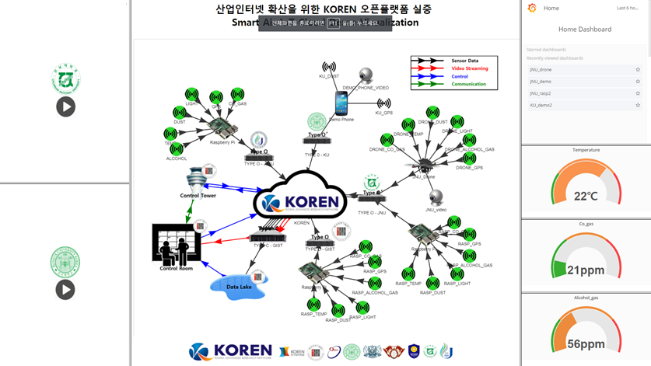
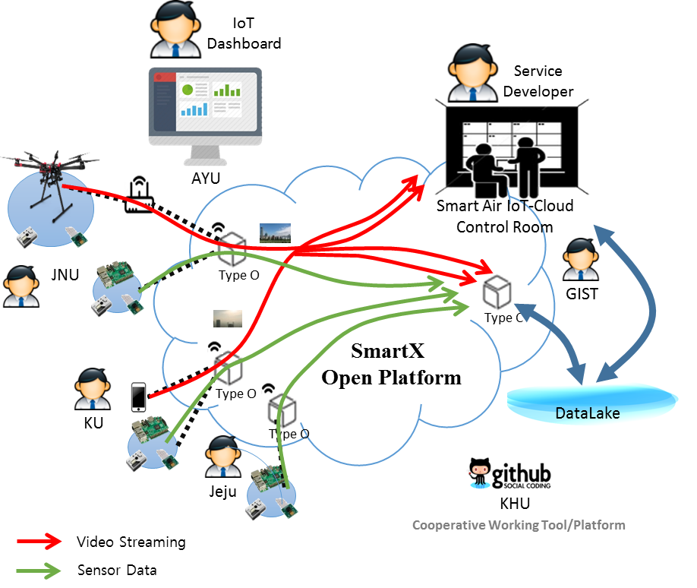






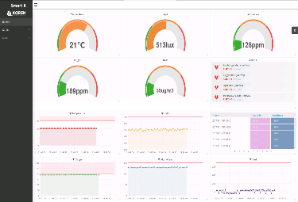
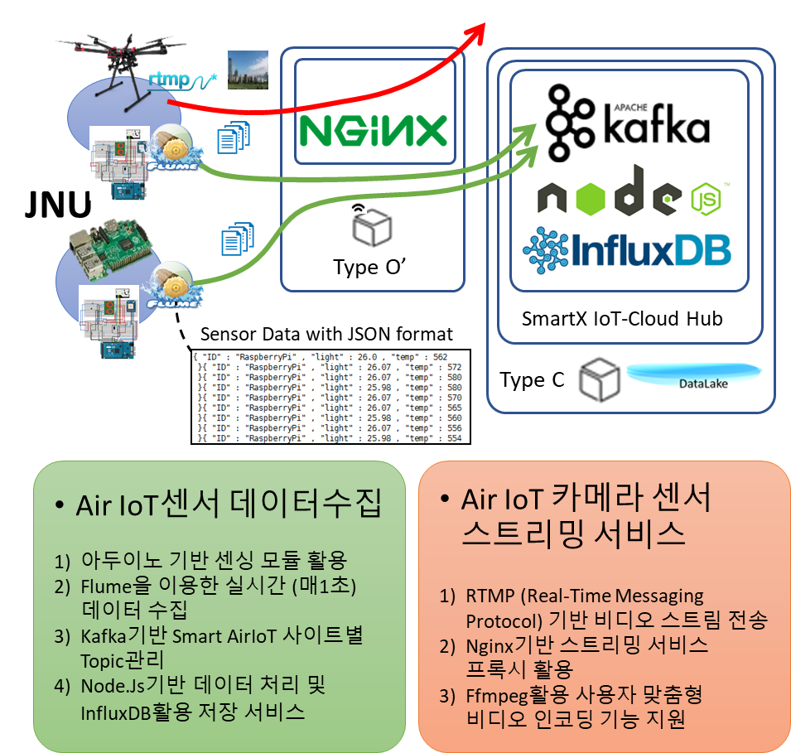
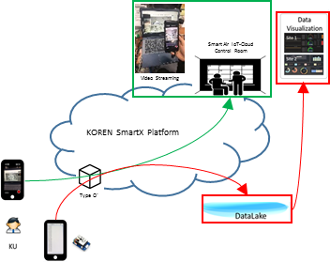
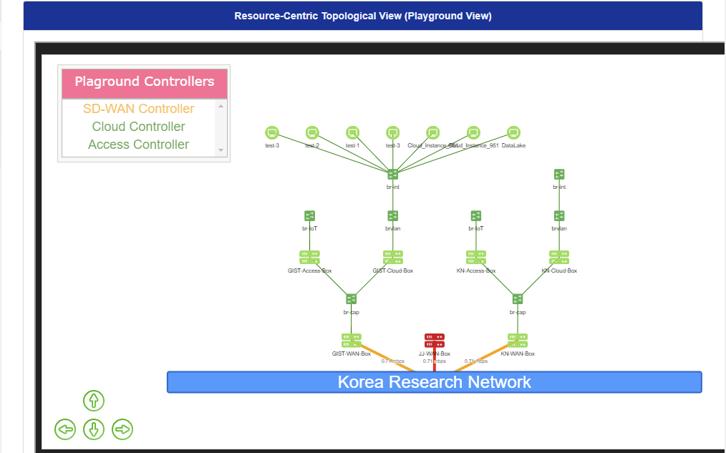
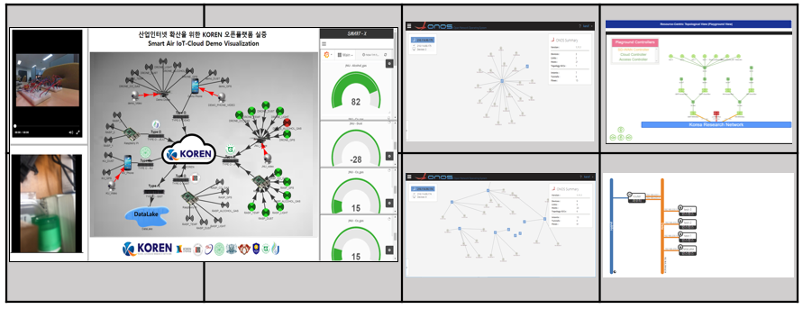
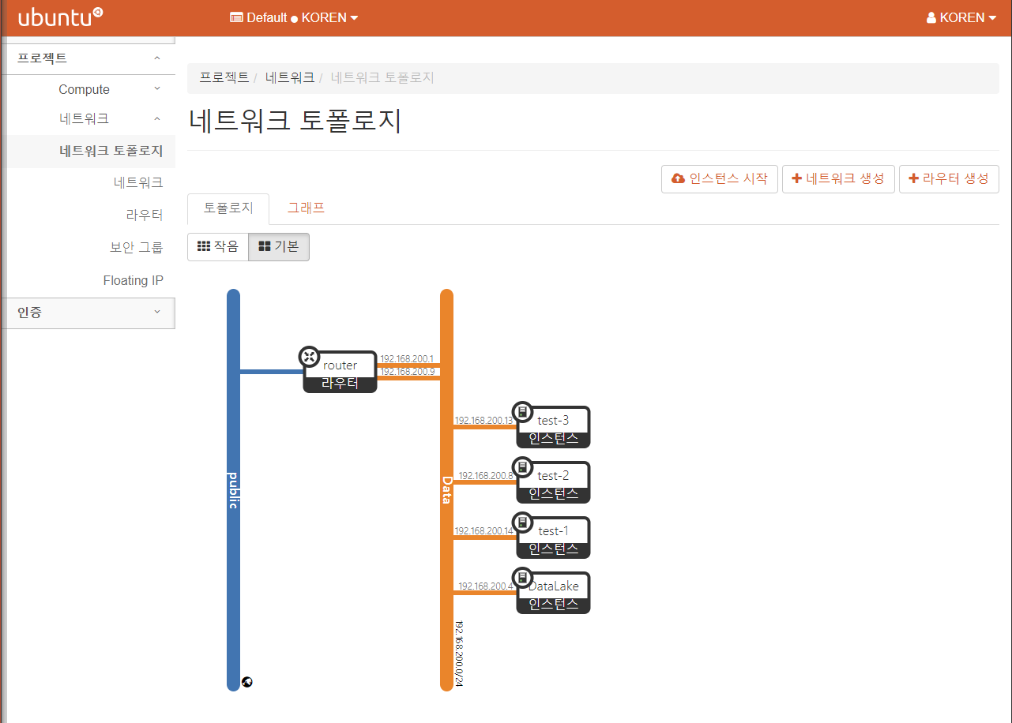
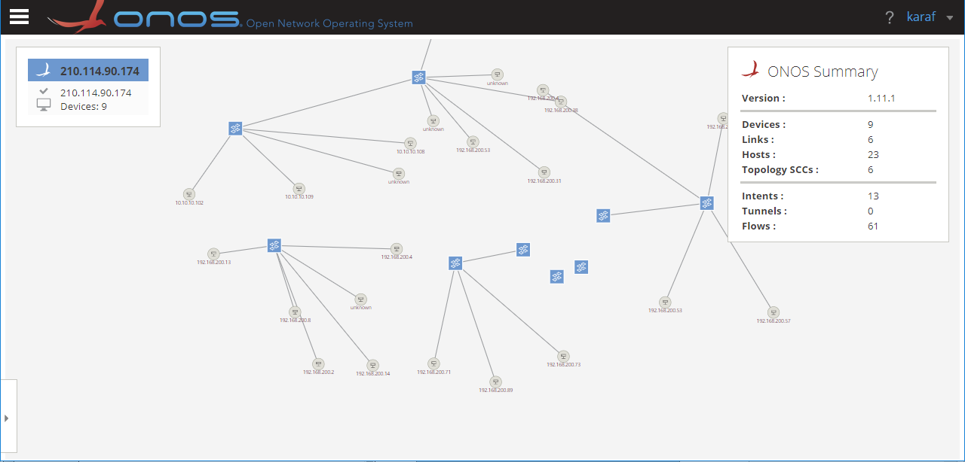










Smart Air IoT-Cloud Services over SmartX Open Platform
KOREN SmartX Platform을 활용한 선택된 산업인터넷 도메인에 대한 서비스 실증: 컨테이너 기반 Smart Air IoT-Cloud 서비스
Smart Air IoT-Service Visualization
Smart Air IoT-Cloud 서비스 Dashboard
Smart Air IoT-Cloud 서비스: Drone
Smart Air IoT-Cloud 서비스: 스마트폰
IoT-Cloud 대응형
SDN/Cloud 기반의 관제타워
SmartX Control Room 내의
타일드 디스플레이 기반의 가시화
동적 IOT 대시보드 구현
1) GRAFANA를 통한 데이터 가시화
2) InfluxDB를 통한 데이터 DB 연동
3) Timeshift를 이용한 실시간 데이터 표시
4) 다양한 패널들을 이용한 가시성 향상
데이터 가시화 웹 구현
1) Bootstrap기반 가벼운 웹 구축 및 Bootstap.js 활용
2) Nginx 기반 반응 Theme 활용
3) 편리한 디자인으로 사용성 개선
1) 스마트 폰에 연결된 먼지센서에서 발생한 데이터와 GPS값을 Apache Kafka
Producer를 통해 Data Lake로 전송
2) 스마트 폰에서 촬영한 영상 데이터 RTMP 기반 비디오 스트리밍
1) 종단 자원의 토폴로지/상태 정보 수집 및 가시화
2) OpenStack Neutron 네트워크 토폴로지 정보 가시화
3) ONOS SDN 제어기의 토폴로지 정보 가시화
1) SmartX Playground의 인프라와 서비스의 효과적인 관제를 위한 Control Room 구축
2) GIST 사이트 내에 위치한 타일드 디스플레이를 이용한 모니터링 지원

Slide 7
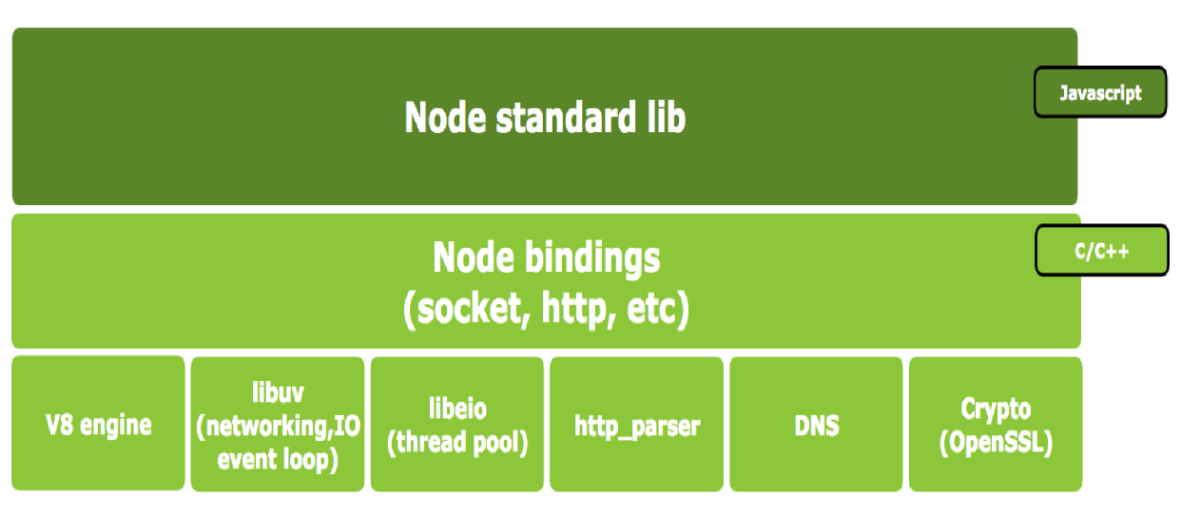
Node.js Web Server Programming
Web Browser
Server-side JavaScript
Database
Web Browser
Web Browser
Web Browser
Client-side Script
(Java Script)
Client-side Script
(Java Script)
Client-side Script
(Java Script)
Client-side Script
(Java Script)
Web Browser
Web
Server
(Daemon/
Service)
Server-side Script
(JSP, PHP, ASP, …)
Database
Web Browser
Node.js Pros: Server-side JavaScript → High productivity; Single thread, non-block I/O → light-weight and agile; no direct I/O → no process blocking
Node.js Cons: Single thread → Complicated multi-process management for multi-core CPU efficiency; Overlapped event callback → callback hell; Memory management overhead due to Garbage Collection
Web Browser
Web Browser
Client-side Script
(Java Script)
Client-side Script
(Java Script)
Client-side Script
(Java Script)
Client-side Script
(Java Script)

Slide 8







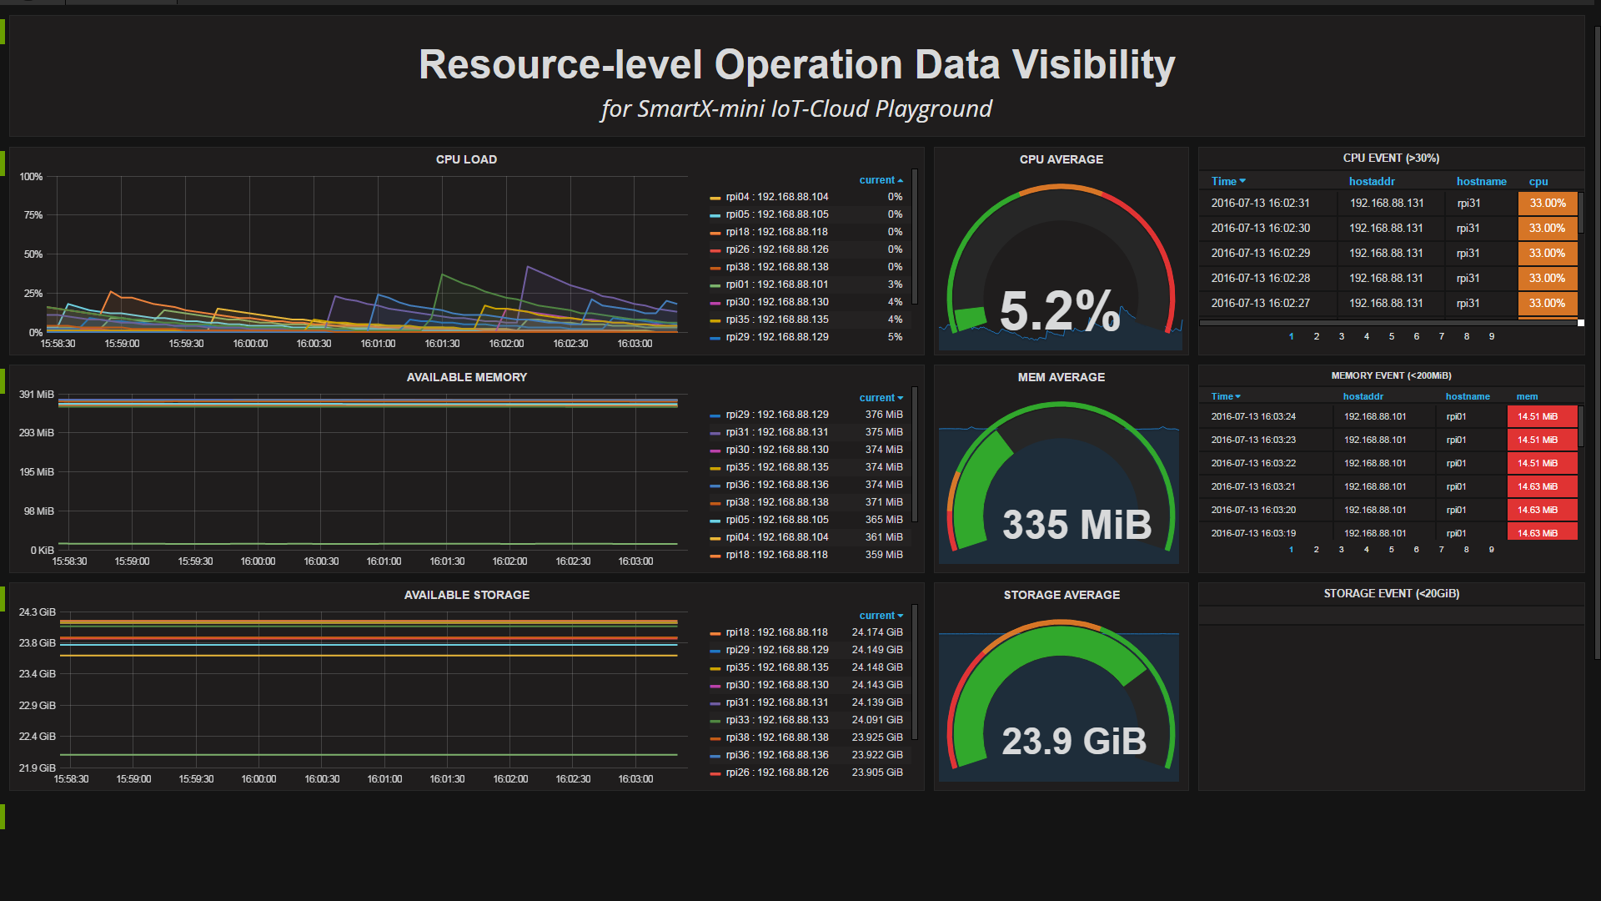



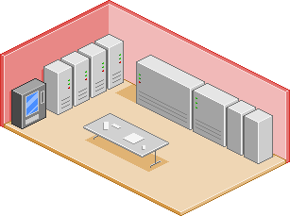
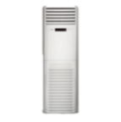

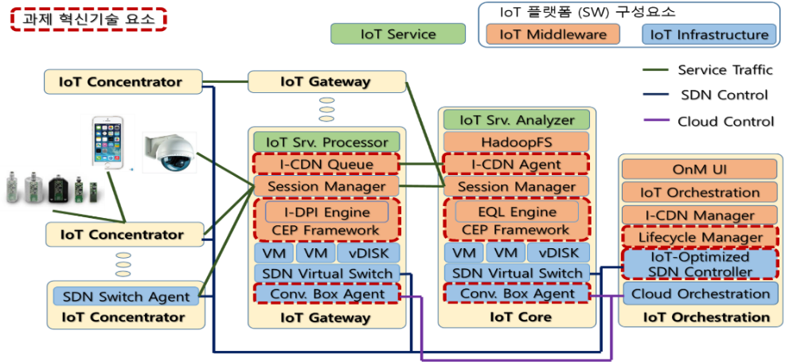


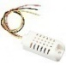
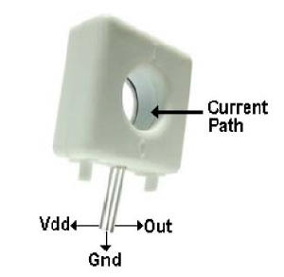
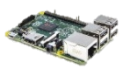





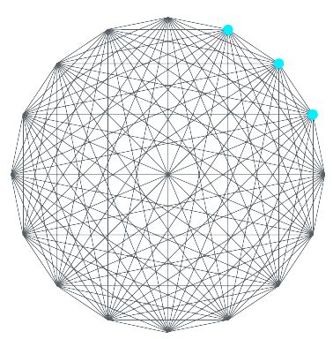







SmartX IoT-Cloud Services for Smart Energy Domain
Smart Energy IoT-Cloud Services for Mini Data Center
Docker Orchestration
Lifecycle Manager
Control & Management
Smart Energy Orchestration
Sensors
&
Actuators
IoT Concentrator
IoT-Cloud Hub
Application Visualization
Data Collection / Validation
Data Lake
Dev Tower
Ops Tower
IoT Concentrator
IoT Gateway
IoT Orchestration
DPI Framework
I-CDNQ
CEP Framework
DashBoard
IoT Service, Processor
API endpoint
DPI
Executor
IoT Service, Analyzer
API endpoint
EQL
Executor
IoT Orchestration
I-CDN Manager
Input Adapter
I-CDN Manager
IoT SDN Controller
Mini DataCenter
IoT Concentrator
Connectivity Manager
I-CDN Agent
G/W, Core
Lifecycle Manager
Cloud Orchestration
VM
VM
Container
VM
VM
Container
Cloud Orchestration
SDN Virtual Switch
SDN Virtual Switch
IoT Orchestration
SDN Switch Agent
Conv. Box Agent
Conv. Box Agent
IoT-Optimized
SDN Controller
IoT Concentrator
IoT Concentrator
IoT Gateway
IoT Core
IoT SDN Controller
IoT Gateway
IoT Core
I-CDN
I-CDN
DevOps Tower Resources
IoT Concentrator
CEP

Slide 9
Practice

Slide 10
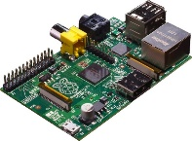
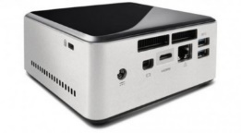
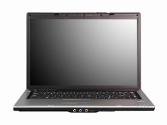

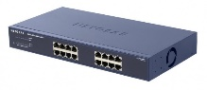
NAME: NUC5i5MYHE (NUC PC) CPU: i5-5300U @2.30GHz CORE: 4 Memory: 16GB DDR3 HDD: 94GB
#0 Lab Preparation (1/2)
Wired connection
NAME: Raspberry Pi Model B (Pi) CPU: ARM Cortex A7 @900MHz CORE: 4 Memory: 1GB SD Card: 32GB
NAME: NT900X3A
CPU: i5-2537U @1.40GHz
CORE: 2 Memory: 4GB DDR3 HDD: 128GB
NAME: netgear prosafe 16 port gigabit switch(Switch) Network Ports: 16 auto-sensing 10/100/1000 Mbps Ethernet ports

Slide 11
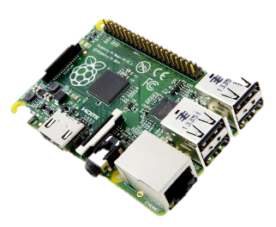
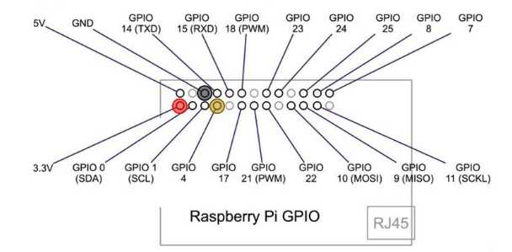
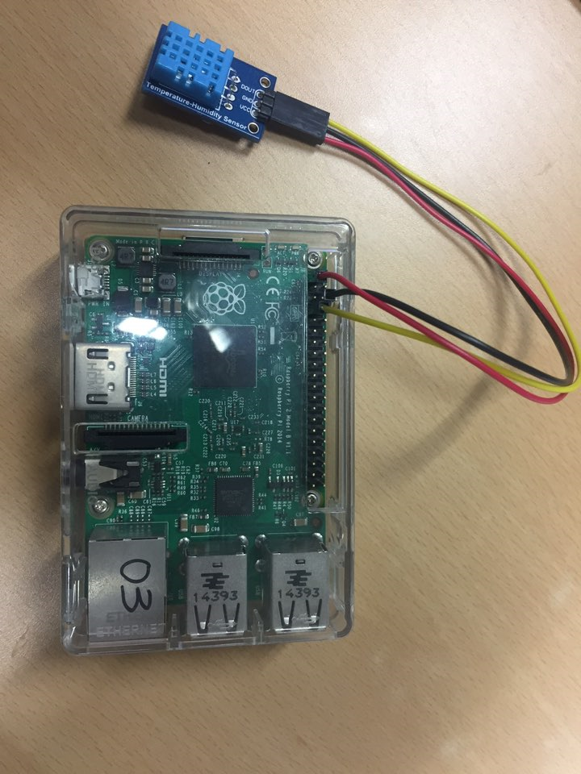
#0 Lab Preparation (2/2)

Slide 12
IoT Lab: Concept
Box provisioning / visibility
Sensor control message
Data Capture Function
Data Transfer Function
Web Server Function
Temperature/Humidity Sensor data
Docker
Runtime
Raspberry Pi Box
for IoT Sensors
& Actuators
NUC Box
for IoT-Cloud Hub
Tower Box
for IoT-Cloud Service Visualization

Slide 13
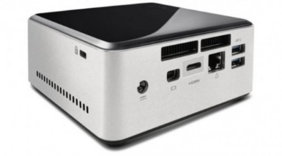

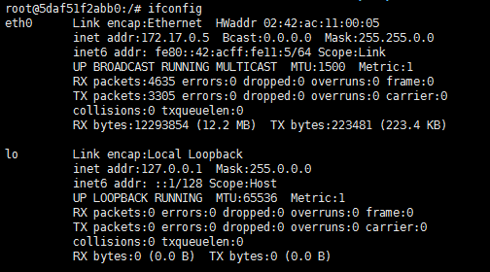
#1-1 Docker Container for Node.js Web Server: Run Container
Run a Docker Container
$ sudo docker run -it --net=host --name=webserver lshyeung/smartx_webserver
On container
# apt-get update
# apt-get install vim

Slide 14
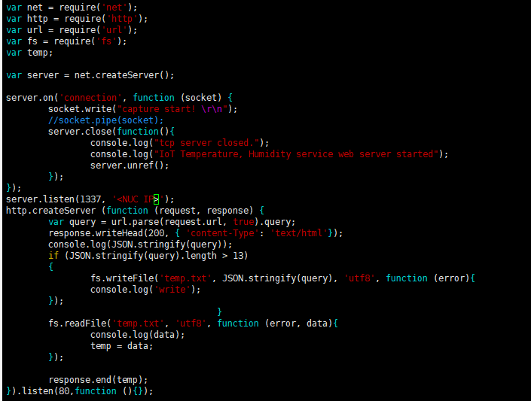
#1–2 Docker Container for Node.js Web Server: Server code
Open Server code and change NUC IP
# vi ~/SmartX-mini/IoT-labs/webserver.js

Slide 15
#2–1 Temperature / Humidity Sensor test on Raspberry PI: Install package
Download package from GitHub
$ git clone https://github.com/adafruit/Adafruit_python_DHT.git
Install package
$ cd Adafruit_python_DHT
$ sudo apt-get update
$ sudo apt-get install python3-pip
$ sudo python3 -m pip install --upgrade pip setuptools wheel
$ sudo python3 setup.py install
If you have error while build package.
$ sudo apt install -y build-essential python3-dev

Slide 16
#2–2 Temperature / Humidity Sensor test on Raspberry PI: Sensor test
Move to example directory
$ cd ~/Adafruit_python_DHT/examples
Modify test code (Change python to python 3)
$ sudo vi AdafruitDHT.py
Execute test code
$ sudo ./AdafruitDHT.py 11 4

Slide 17
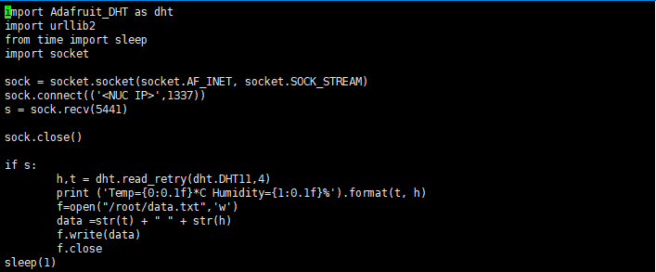
#3–1 Sensor Data Capture and Transfer: Sensor Data capture code
Install dependencies at RPi
$ sudo apt-get update
$ sudo apt-get install libpython3.6-dev python3-numpy
$ sudo apt-get install mercurial
Open Sensor Data Capture code and Change IP Address
$ vi ~/SmartX-mini/IoT-Labs/RPI_capture.py

Slide 18
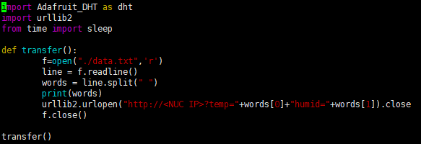
#3–2 Sensor Data Capture and Transfer: Sensor Data transfer code
Open Sensor Data Capture code and Change IP Address
$ vi ~/SmartX-mini/IoT-Labs/RPI_transfer.py

Slide 19

#4 Execute IoT Web service
At the Docker container in NUC (Webserver)
$ cd ~/SmartX-mini/IoT-labs
$ nodejs webserver.js
At the Laptop (Tower)
Open Web browser and go to http://<NUC_IP>
At the Rpi (Sensor Data Capture and Transfer)
$ cd ~/SmartX-mini/IoT-labs
$ chmod +x process.sh
$ sudo ./process.sh

Slide 20
Review

Slide 21
Lab Summary
With IoT Lab, you have experimented
An example-based realization of container-based IoT-Cloud services that can sense and actuate distributed IoT devices (i.e., Boxes).
For the cloud side, the required Web-app server realization is supported by utilizing Node.js programming.

Slide 22
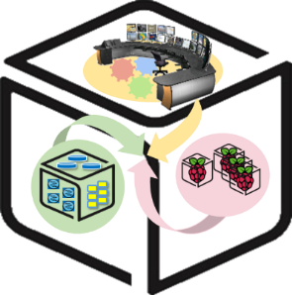
Thank You for Your Attention
Any Questions?
mini@smartx.kr

